Slide 1
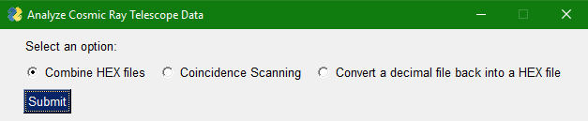
Analyze CR Data

Slide 2
Software
Python 3
Libraries (installed using pip):
PySimpleGUI
openpyxl

Slide 3
Operation (long)
Combining HEX files (slide 3 through slide )

Slide 4
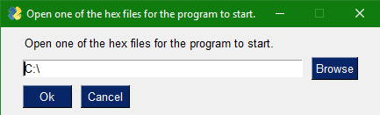
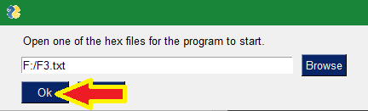
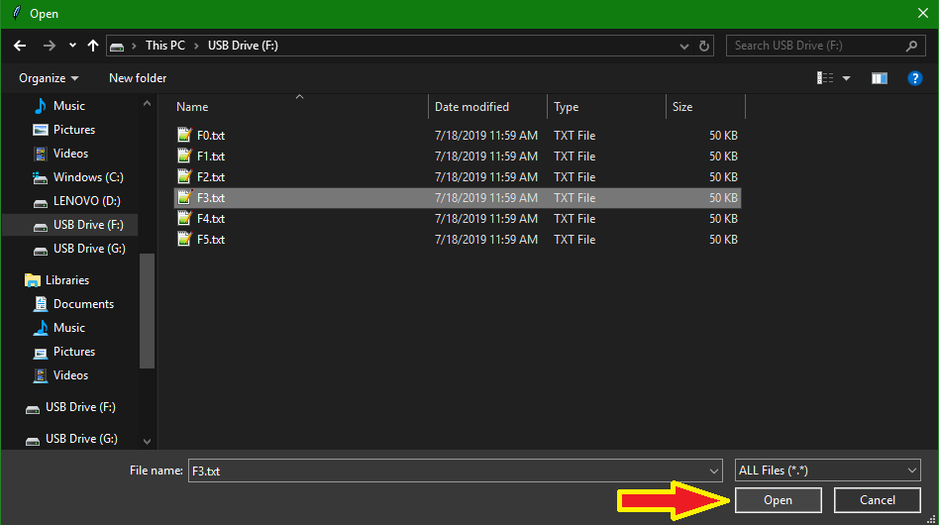
Locate the HEX files for the program
1.
3.
2.

Slide 5
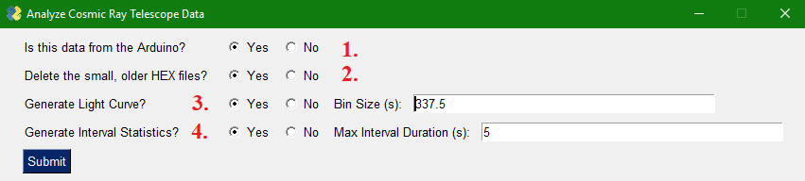
Analysis Options
Adjusts the factor that is used for hex-to-decimal conversion. Also changes automatic dead time correction.
Make the program automatically delete all of the “F.txt” files after it has successfully combined them into a HEX file.
The program will generate an excel file with a light curve.
The program will add interval statistics to the light curve. The interval bin size is fixed to be 1/244.1 s.

Slide 6
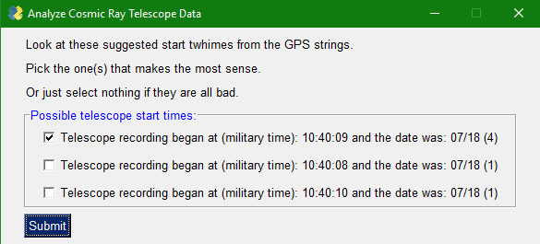
Analysis Options (Continued)
The program looks at every GPS string and calculates when is t=0 in ET (automatically knows if we are in EDT or EST)
Use the checkboxes to select any interesting GPS times.
Limitation: Cannot display more than 12 unique GPS times or the program will crash due to GUI error.
Number in parenthesis is the amount of occurrences of that starting time.

Slide 7
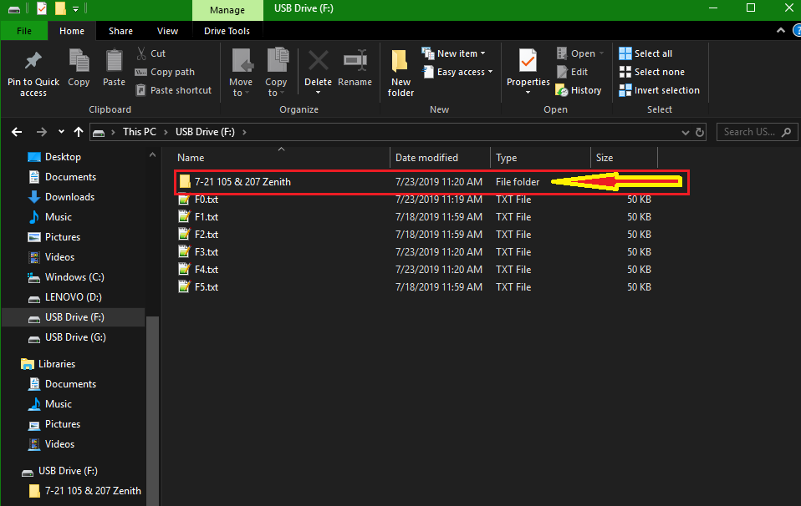
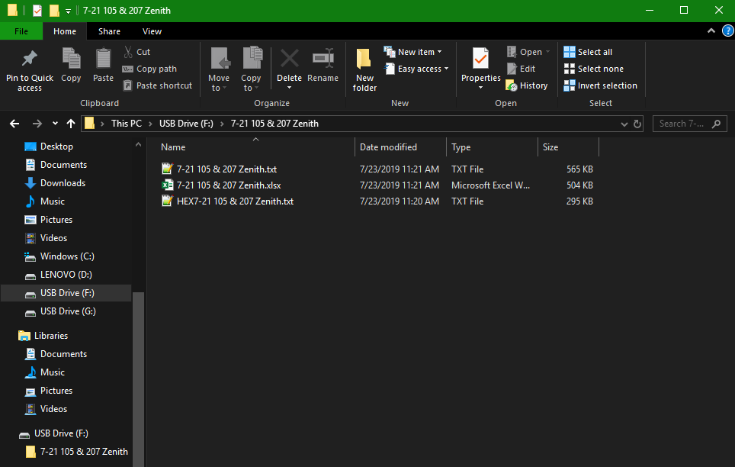
Program Output

Slide 8
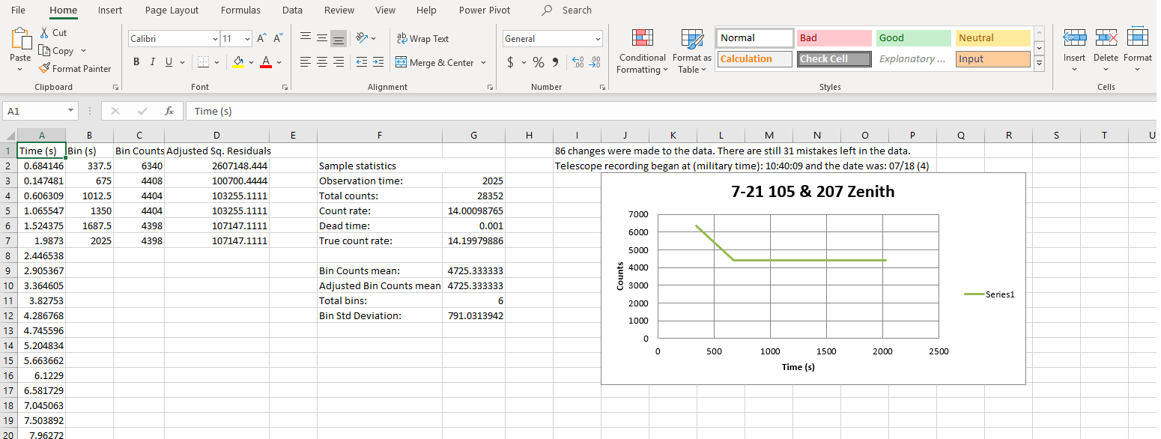
Light Curve

Slide 9
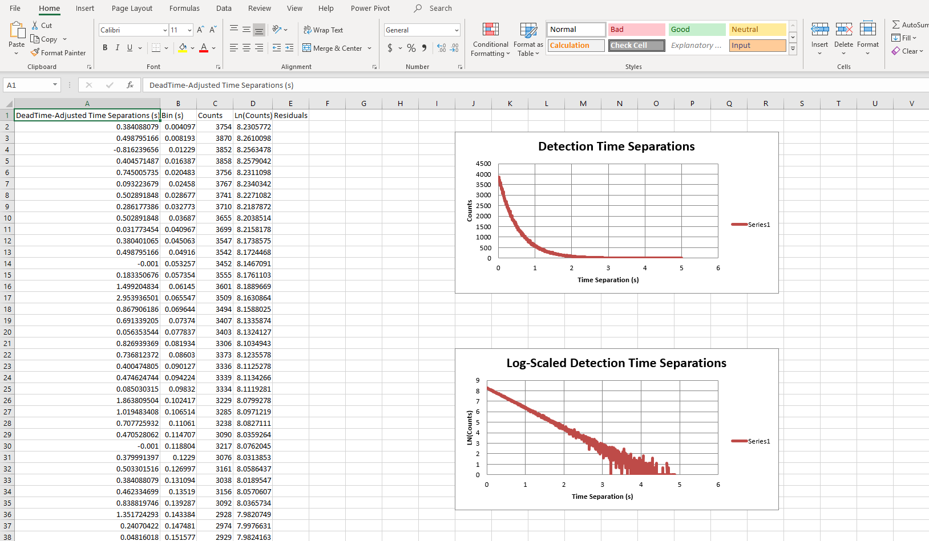
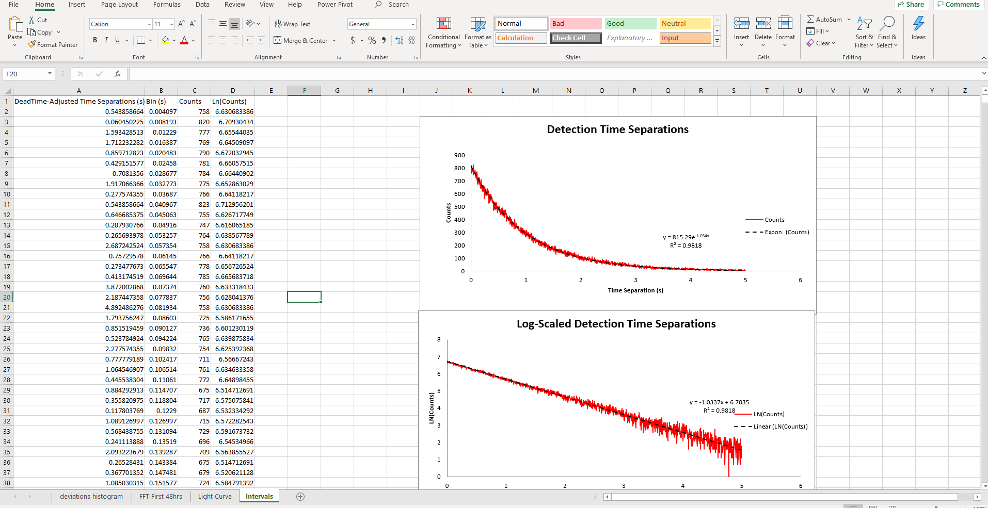
Intervals

